Slide 1
INTRO TO GIS FOR ENVIRONMENTAL SCIENCE
WEEK 1 LECTURE SLIDES

Slide 2
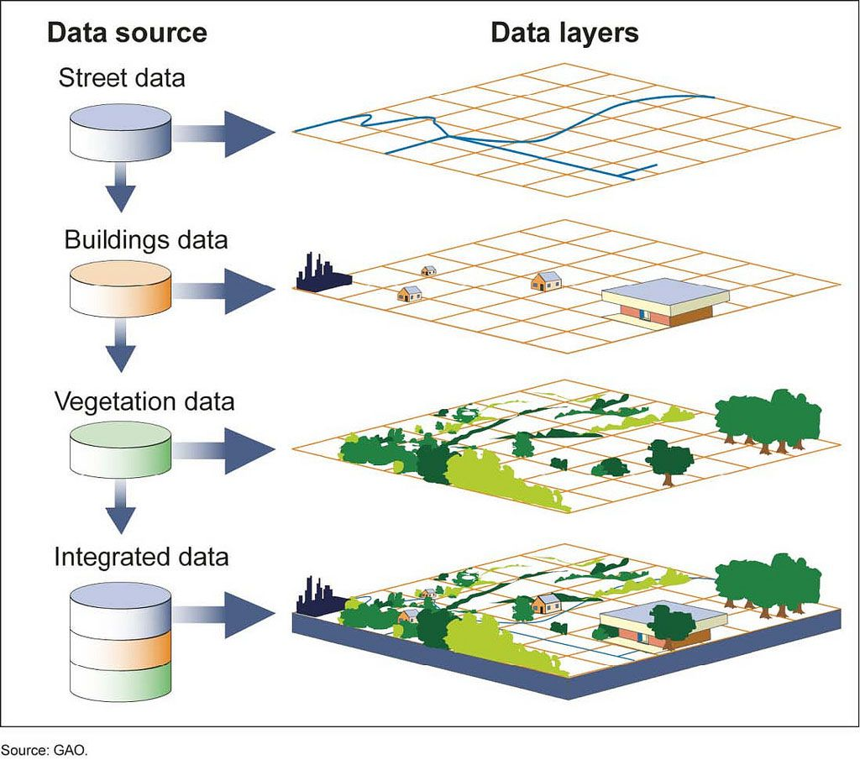
Outline
Your Professor
Lectures, Labs, and Exams
The Power of GIS
ESRI and other platforms
Begin Lab 1
Example practical exam

Slide 3
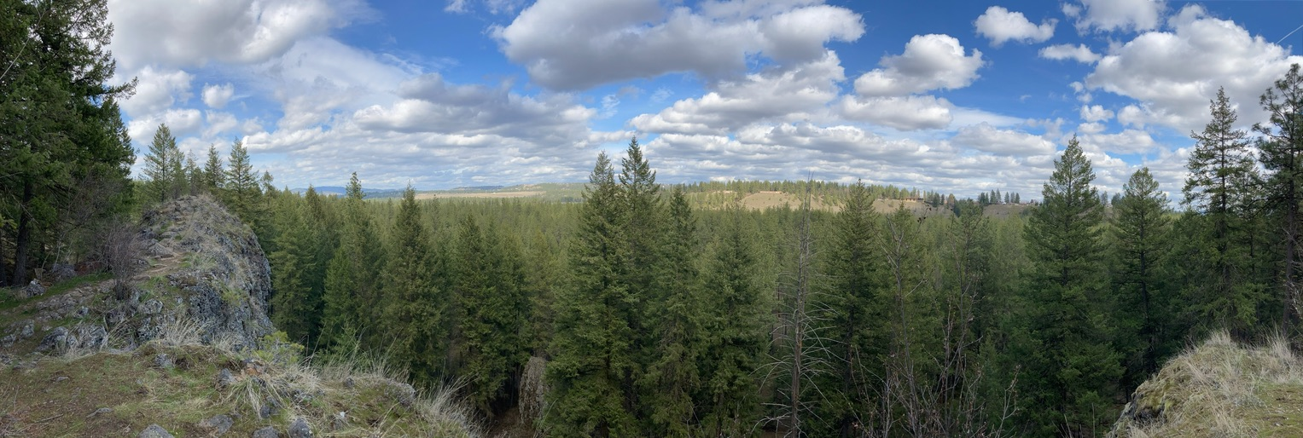
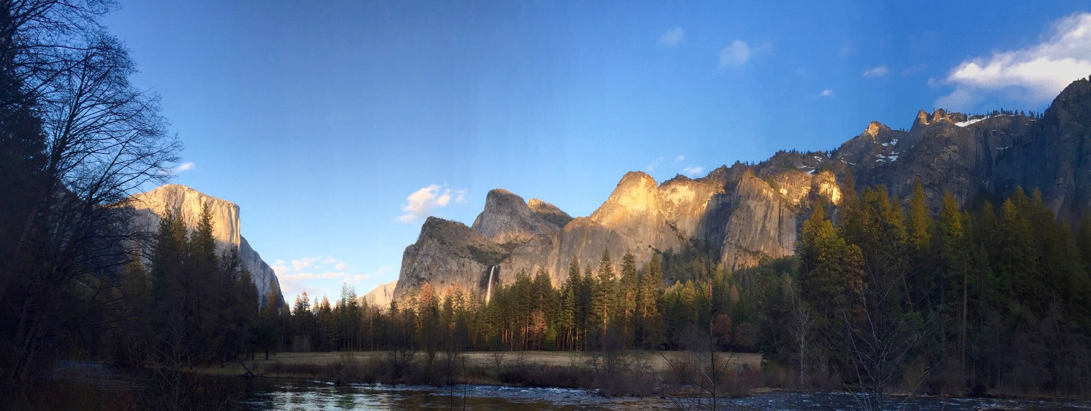
Your Professor
I’ve been all over the country conducting fieldwork. I am interested in evaluating and characterizing environmental activity.
Here are pictures from field scouting trips for evidence of fire activity.
Would you be surprised to learn there was more fire on the landscape 100+ years ago than there is today?

Slide 4
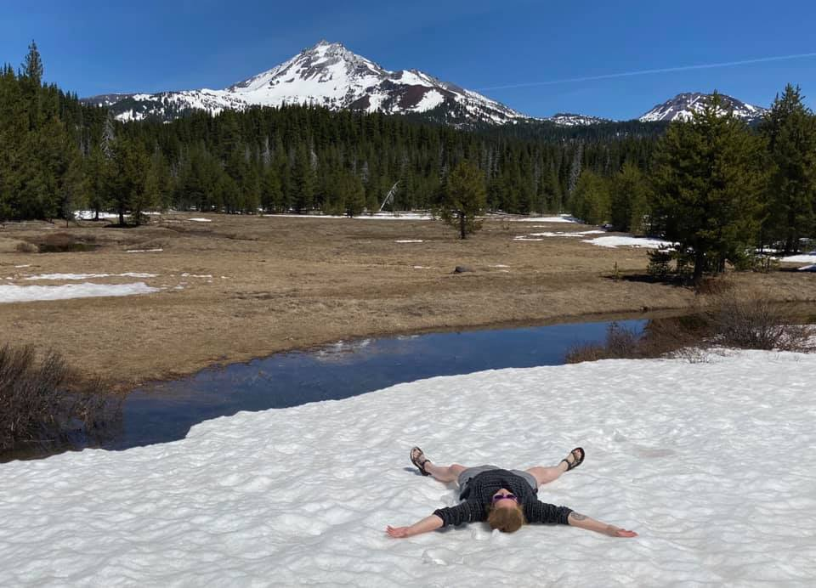
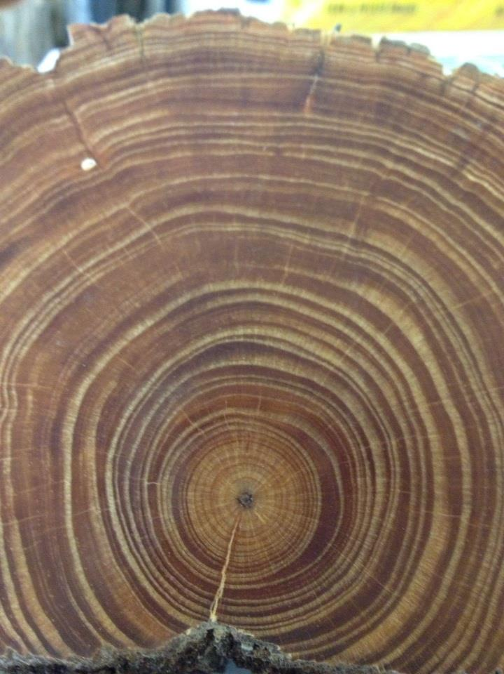
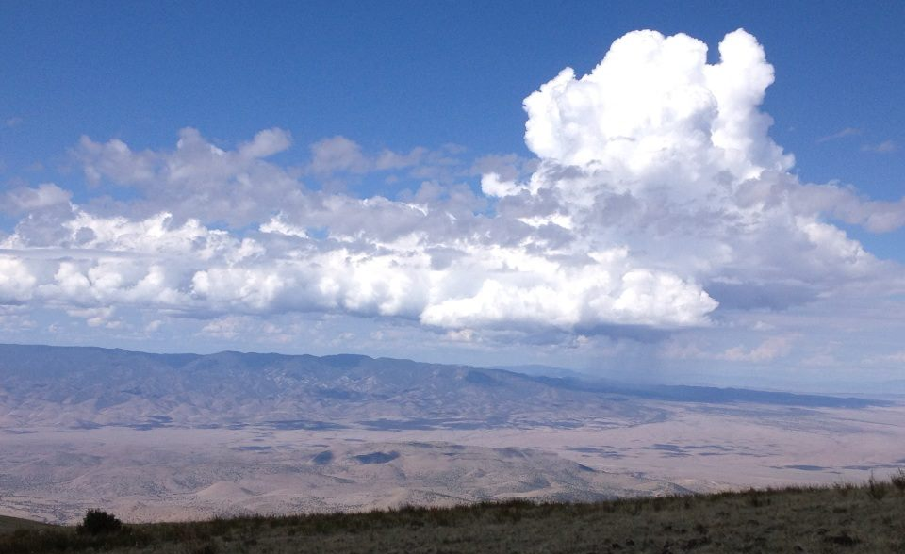
Your Professor
Research interests include wildfires, GIS, anthropogenic climate change, and SciComm
Do you have similar interests? Reach out! My lab is always looking for dedicated undergrads interested in fire activity, tree rings, and GIS! ☺

Slide 5
Your Professor
Dr. Lauren Stachowiak
lstachowiak@ewu.edu is the best way to contact me!
Check out my personal webpage here: https://laurenstachowiak.wordpress.com/
I have a YouTube channel where I’ve been posting ”How-To” videos related to dendrochronology: https://www.youtube.com/channel/UCPcHT5o1CoitQ4hHalsecpA/about

Slide 6
LECTURES, labs, and exams
Each week I will demonstrate a series of common GIS tools or data management protocols and a lab scenario or topic.
Mondays will be for brief lecture and demos of the primary topics for the week. The second half of class will begin each lab.
Wednesdays will primarily be open lab time where you will have access to the GIS lab to complete the weekly lab tasks.
Some labs will be multi-part and cover multiple weeks.
In Week 5 and Week 10, you will have a practical exam to complete. The exam will require you to complete ten operations/tasks within the class period. More information on the practical exams will be given closer to their dates.

Slide 7
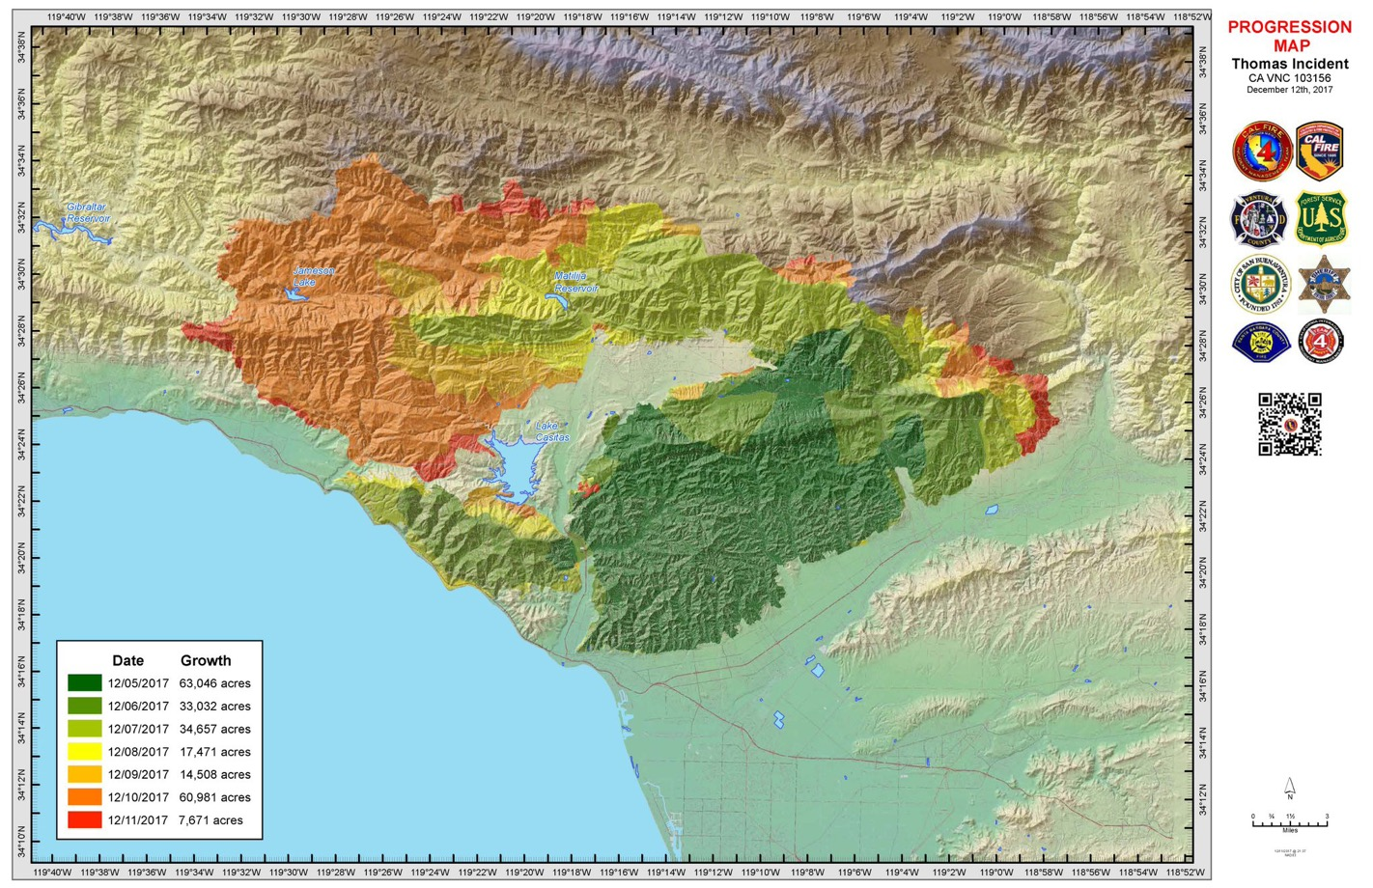
GISystems are powerful tools that can be used to analyze and display various types of multi-dimensional data at once. What is the map below telling you?

Slide 8
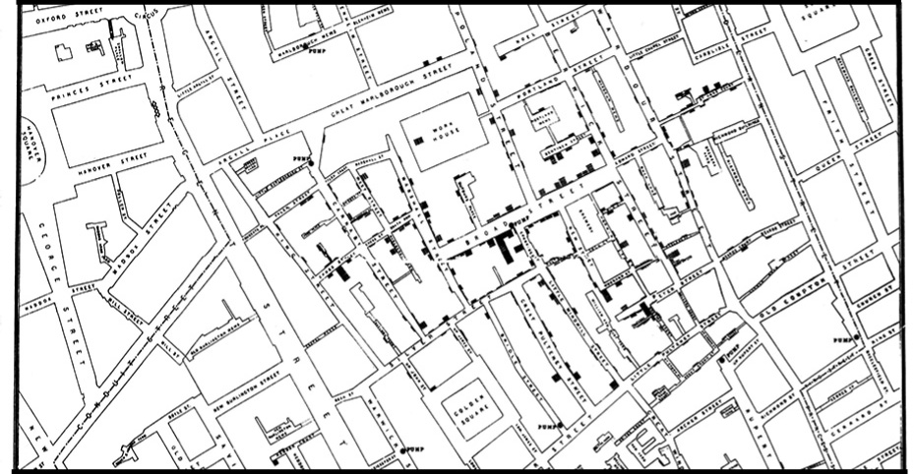
The Power of GIS
John Snow’s 1854 Cholera Map

Slide 9
The power of gis
A regional time series dataset for future maximum temps above 35C (IPCC WGI, 2021). Is this a geovisualization? Would you consider this a GIS? https://interactive-atlas.ipcc.ch/

Slide 10
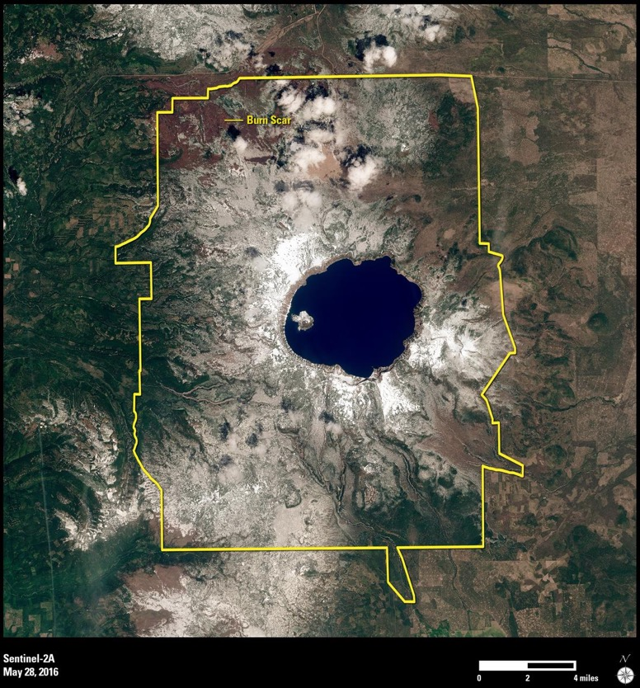
Remote Sensing and Contemporary GIS
Remotely sensed data are those collected away from their observation
Remote sensors specialize in satellites and the EM spectrum, which can offer a wealth of data beyond the visible light spectrum
Increasingly fine spatial resolution capabilities has provided for truly rich imagery and data.

Slide 11
ESRI
Motto is “The Science of Where”
The gold-standard for proprietary GIS software. Start here to begin exploring what ESRI has to offer (it’s quite a bit): https://www.esri.com/en-us/home
ArcDesktop Suite contained several separate programs, such as ArcMap and ArcScene. All are now housed within ArcGIS Pro, the desktop GIS software program.
Available now via personal licenses for. approx. $100/year – this is a massive discount, the program used to be $1000s per license “back in the day” ☺

Slide 12
ESRI
Building and using GIS apps has become an area of rapid development in GIS
Mobile apps allow a completely different approach to GIS and the inclusion of people that cannot access high-tech equipment.
https://www.esri.com/en-us/arcgis/products/apps-for-everyone/overview
Your smart phone is virtually as powerful at geolocating as any standard GPS today, the primary limitations are the cellular service and your use (locating your car with a dropped pin in a large parking lot vs. mapping fine scale artifacts in an archaeology dig).

Slide 13
esri
StoryMaps and ArcGIS online, build geovisualizations and spatial stories
https://www.esri.com/en-us/arcgis/products/arcgis-storymaps/overview
Examples to explore!
Wildfire in the West: https://storymaps.arcgis.com/stories/bb7fe74c1f9f4fec8910a1b39e1c42ff
Coastal Flooding: https://storymaps.arcgis.com/stories/4faf6d052c8f41b3b9b99c506642bca5
Tropical Cyclones: https://storymaps.arcgis.com/stories/7cafb5298c3143b19b6e06a1d5a309f4?adumkts=product

Slide 14
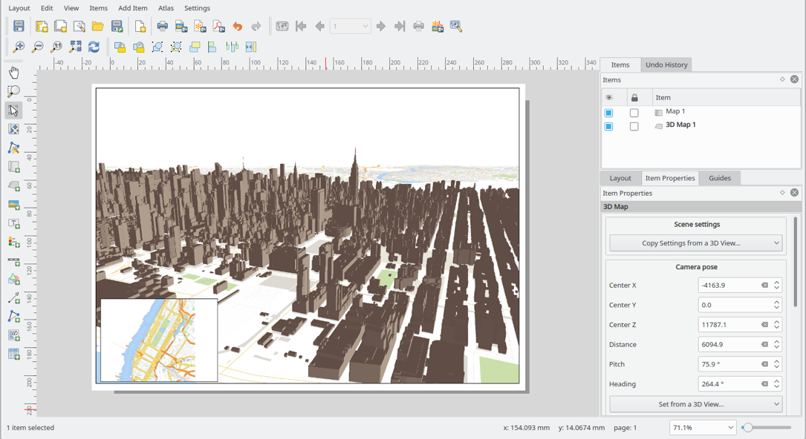
QGIS
The most well-known open-source desktop GIS software, available for free download here: https://qgis.org/en/site/ on both PC and Mac operating systems
Comparable to ArcDesktop suite, but with less formalized support (common with open-source software)
NOT ALL PLUGINS ARE MAC COMPATIBLE EVEN THOUGH QGIS AS A PROGRAM IS.

Slide 15
Google earth engine and COLAB
The Future hah!
You will need to signup for a free GEE code editor account, it’s worth it.
In-browser analyses with massive amounts of free data
Ability to build apps, sync Colab Notebooks, and share everything you build immediately online.
Downside: GEE works only with Java, but Google Colab uses Python or R, and not for professional/proprietary use (i.e. you can’t make money using the platform)
Start your GEE journey here: https://developers.google.com/earth-engine
Start your Colab journey here: https://colab.research.google.com/notebooks/intro.ipynb

Slide 16
Lab #1
All materials you will need for Lab 1 are located in the Lab 1 folder on the course Canvas page.
Skills/tools we will cover in Lab 1:
GIS data storage
Root drives
Folder and file scaffolding
Copies and redundancies
NON-NEGOTIABLE RULES FOR DATA STORAGE – I DON’T MAKE ‘EM BUT THE PROGRAM WON’T WORK IF YOU DON’T FOLLOW ‘EM!
Opening ArcGIS Pro and starting a new map
Adding data to your map
Making a basic map layout

Slide 17
EXAMPLE PRACTICAL EXAM
Using the appropriate root drive for campus data storage, create the correct folder setup for spatial data storage for this practice exam. Your naming conventions can be unique to you, but you must follow the “non-negotiable rules for data storage” when doing so.
Download the data for the exam from Canvas and save to the folder you created for this practice exam.
Open ArcGIS Pro and without starting a new project, insert a new map frame and add the data.
In the Table of Contents pane, rename your map to “Stellar Cartography”
Insert a map layout and include: map frame, legend, north arrow, scale bar, and title.
With the map layout showing AND the table of contents visible, take a screen shot of your PC screen and save it as a JPEG to the same folder you have created for this exam.
Submit the following to complete the practice exam: (1) the JPEG screen shot, (2)the full path name for the JPEG, (3) a screenshot of the file explorer window with the folder you have created for the exam visible, and finally (4) the full path name for that folder to the appropriate assignment dropbox on Canvas. You can create a word document with each screenshot and the path names listed on the page, and then submit the word document as either a .docx or PDF.

